Slide 1
Tracking Objects with Dynamics
04/19/11
Computer Vision
CS 543 / ECE 549
University of Illinois
Derek Hoiem
Slides from Lana Lazebnik, Kristen Grauman, Deva Ramanan

Slide 2
Misc
Categorization problem in HW 3
Time for the poster session
12-2pm not possible
10:30-1pm, with pizza at 12pm?
2:30-5pm, with snacks of some sort?

Slide 3
Recent classes
Point correspondences for
Image stitching
Stereo and depth estimation
Tracking points
Structure from motion

Slide 4
Today: Tracking Objects
Goal: Detect and link positions/pose of objects across video frames
Traffic camera
http://www.youtube.com/watch?v=j2C99h6ndS8
Football
http://www.youtube.com/watch?v=odbp6Cg5mC4
Tennis
http://www.youtube.com/watch?v=T7PLgsQHibg

Slide 5
Why do we want to track objects?
Motion capture / animation: http://www.youtube.com/watch?v=eYSXaU6eKm4
Scene understanding
Action recognition
Security, traffic monitoring
Video summarization

Slide 6
Things that make visual tracking difficult
Objects that are hard to detect
Small, few visual features
Erratic movements
Moving very quickly
Occlusions
Objects may leave and come back
Surrounding similar-looking objects

Slide 7
This class
Overview of probabilistic tracking
Kalman filter
Particle filter
Example of tracking people

Slide 8
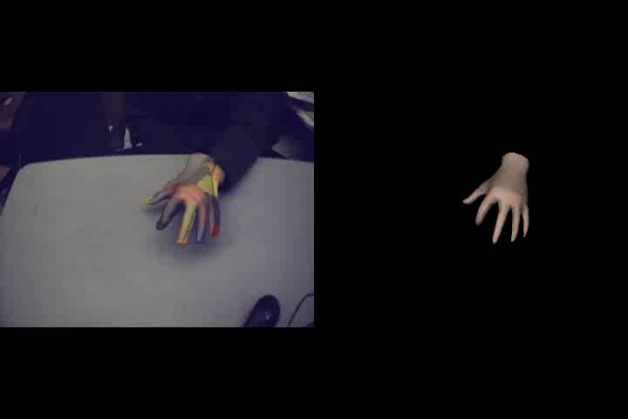
Strategies for tracking
Tracking by repeated detection
Works well if object is easily detectable (e.g., face or colored glove) and there is only one
http://people.csail.mit.edu/rywang/handtracking/
Might want to update appearance model to fit a particular instance
Need some way to link up detections
Best you can do, if you can’t predict motion

Slide 9
Tracking with dynamics
Key idea: Based on a model of expected motion, predict where objects will occur in next frame, before even seeing the image
Restrict search for the object
Improve estimates; measurement noise is reduced by trajectory smoothness
Robustness to missing or weak observations
Following slides adapted from Lana Lazebnik,
who adapted them from Kristen Grauman and Deva Ramanan

Slide 10
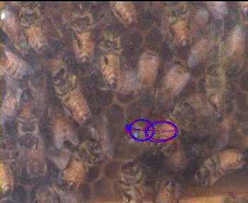
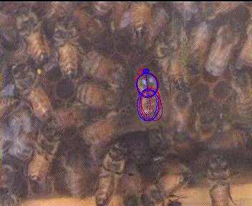
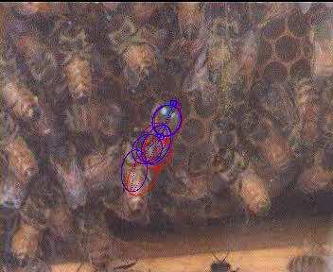
Strategies for tracking
Tracking with motion prediction
Predict the object’s state in the next frame
Kalman filtering: next state can be linearly predicted from current state (Gaussian)
Particle filtering: sample multiple possible states of the object (non-parametric, good for clutter)
“Tracking Bees in a Hive”, Veeraraghavan and Chellappa

Slide 11
General model for tracking
The moving object of interest is characterized by an underlying state X
State could be any combination of position, pose, viewpoint, velocity, acceleration, etc.
State X gives rise to measurements or observations Y
At each time t, the state changes to X_{t} and we get a new observation Y_{t}

Slide 12
Steps of tracking
Prediction: What is the next state of the object given past measurements?

Slide 13
Steps of tracking
Prediction: What is the next state of the object given past measurements?
Correction: Compute an updated estimate of the state from prediction and measurements

Slide 14
Steps of tracking
Prediction: What is the next state of the object given past measurements?
Correction: Compute an updated estimate of the state from prediction and measurements
Tracking can be seen as the process of propagating the probability of state given measurements across time

Slide 15
Simplifying assumptions
Only the immediate past matters
dynamics model

Slide 16
Simplifying assumptions
Only the immediate past matters
Measurements depend only on the current state
dynamics model
observation model

Slide 17
Simplifying assumptions
Only the immediate past matters
Measurements depend only on the current state
dynamics model
observation model
…
X₀
X₁
X₂
X_{t-1}
X_{t}
Y₀
Y₁
Y₂
Y_{t-1}
Y_{t}

Slide 18
Problem statement
We have models for
Likelihood of next state given current state:
Likelihood of observation given the state:
We want to recover, for each t:

Slide 19
Tracking as induction
Base case:
Start with initial prior that predicts state in absence of any evidence: P(X₀)
For the first frame, correct this given the first measurement: Y₀=y₀

Slide 20
Tracking as induction
Base case:
Start with initial prior that predicts state in absence of any evidence: P(X₀)
For the first frame, correct this given the first measurement: Y₀=y₀

Slide 21
Tracking as induction
Base case:
Start with initial prior that predicts state in absence of any evidence: P(X₀)
For the first frame, correct this given the first measurement: Y₀=y₀
Given corrected estimate for frame t-1:
Predict for frame t ➔
Observe y_{t}; Correct for frame t ➔
predict
correct

Slide 22
Prediction
Prediction involves representing given

Slide 23
Prediction
Prediction involves representing given
Law of total probability

Slide 24
Prediction
Prediction involves representing given
Conditioning on X_{t–1}

Slide 25
Prediction
Prediction involves representing given
Independence assumption

Slide 26
Prediction
Prediction involves representing given
dynamics model
corrected estimate from previous step

Slide 27
Correction
Correction involves computing given predicted value

Slide 28
Correction
Correction involves computing given predicted value
Bayes’ Rule

Slide 29
Correction
Correction involves computing given predicted value
Independence assumption (observation y_{t} directly depends only on state X_{t})

Slide 30
Correction
Correction involves computing given predicted value
Conditioning on X_{t}

Slide 31
Correction
Correction involves computing given predicted value
observation model
predicted estimate
normalization factor

Slide 32
Summary: Prediction and correction
Prediction:
Correction:
dynamics model
corrected estimate from previous step
observation model
predicted estimate

Slide 33
The Kalman filter
Linear dynamics model: state undergoes linear transformation plus Gaussian noise
Observation model: measurement is linearly transformed state plus Gaussian noise
The predicted/corrected state distributions are Gaussian
You only need to maintain the mean and covariance
The calculations are easy (all the integrals can be done in closed form)

Slide 34
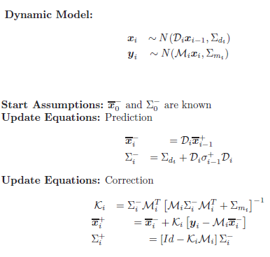
Kalman filter
Example: Suppose that
State X is a vector of {position, velocity, acceleration}
Observation Y is a position (with some noise)

Slide 35
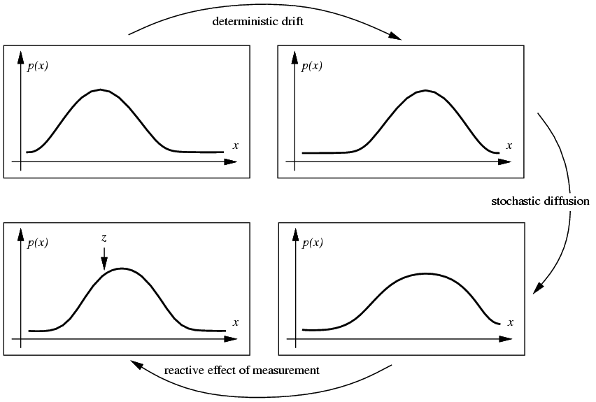
Propagation of Gaussian densities
Current state
Expected change
Decent model if there is just one object, but localization is imprecise
Uncertainty
Observation and Correction

Slide 36
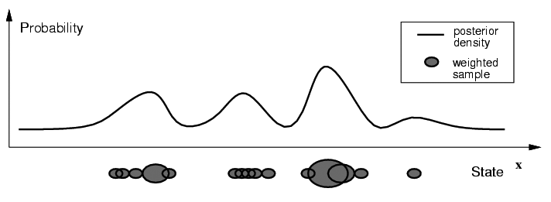
Particle filtering
Represent the state distribution non-parametrically
Prediction: Sample possible values X_{t-1} for the previous state
Correction: Compute likelihood of X_{t} based on weighted samples and P(y_{t}|X_{t})
M. Isard and A. Blake, CONDENSATION -- conditional density propagation for visual tracking, IJCV 29(1):5-28, 1998

Slide 37
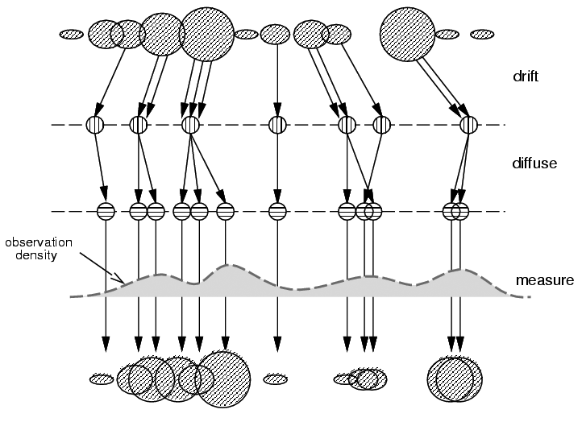
Particle filtering
Start with weighted samples from previous time step
Sample and shift according to dynamics model
Spread due to randomness; this is predicted density P(X_{t}|Y_{t-1})
Weight the samples
according to observation density
Arrive at corrected density estimate P(X_{t}|Y_{t})
M. Isard and A. Blake, CONDENSATION -- conditional density propagation for visual tracking, IJCV 29(1):5-28, 1998

Slide 38
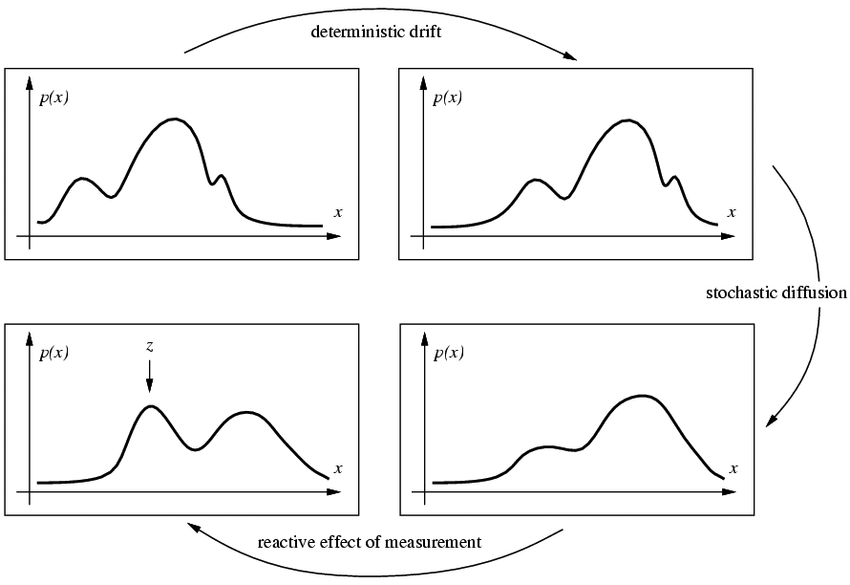
Propagation of non-parametric densities
Current state
Expected change
Good if there are multiple, confusable objects (or clutter) in the scene
Uncertainty
Observation and Correction

Slide 39

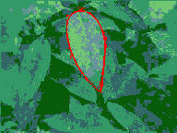
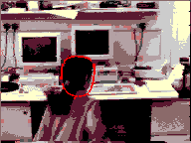
Particle filtering results
http://www.robots.ox.ac.uk/~misard/condensation.html

Slide 40
Tracking issues
Initialization
Manual
Background subtraction
Detection

Slide 41
Tracking issues
Initialization
Getting observation and dynamics models
Observation model: match a template or use a trained detector
Dynamics model: usually specify using domain knowledge

Slide 42
Tracking issues
Initialization
Obtaining observation and dynamics model
Uncertainty of prediction vs. correction
If the dynamics model is too strong, will end up ignoring the data
If the observation model is too strong, tracking is reduced to repeated detection

Slide 43
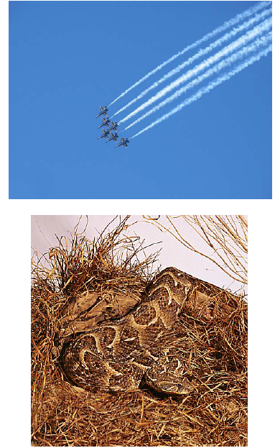
Tracking issues
Initialization
Getting observation and dynamics models
Prediction vs. correction
Data association
When tracking multiple objects, need to assign right objects to right tracks (particle filters good for this)

Slide 44
Tracking issues
Initialization
Getting observation and dynamics models
Prediction vs. correction
Data association
Drift
Errors can accumulate over time

Slide 45
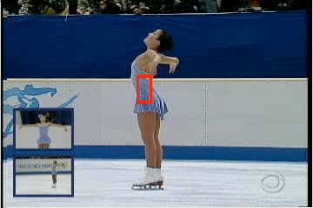
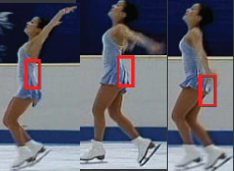
Drift
D. Ramanan, D. Forsyth, and A. Zisserman. Tracking People by Learning their Appearance. PAMI 2007.

Slide 46
Example: Tracking people
Person model = appearance + structure (+ dynamics)
Structure and dynamics are general, appearance is person-specific
Trying to acquire an appearance model “on the fly” can lead to drift
Instead, can use the whole sequence to initialize the appearance model and then keep it fixed while tracking
Given strong structure and appearance models, tracking can essentially be done by repeated detection (with some smoothing)
D. Ramanan, D. Forsyth, and A. Zisserman. Tracking People by Learning their Appearance. PAMI 2007.

Slide 47
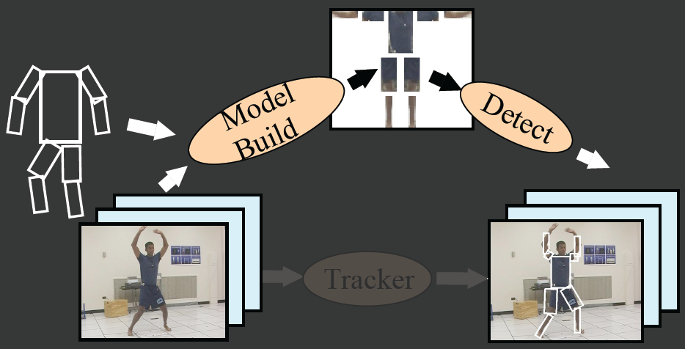
Tracking people by learning their appearance
Tracker
D. Ramanan, D. Forsyth, and A. Zisserman. Tracking People by Learning their Appearance. PAMI 2007.

Slide 48
Bottom-up method to build model: Cluster
D. Ramanan, D. Forsyth, and A. Zisserman. Tracking People by Learning their Appearance. PAMI 2007.

Slide 49
Top-down method to build model: Exploit “easy” poses
D. Ramanan, D. Forsyth, and A. Zisserman. Tracking People by Learning their Appearance. PAMI 2007.

Slide 50
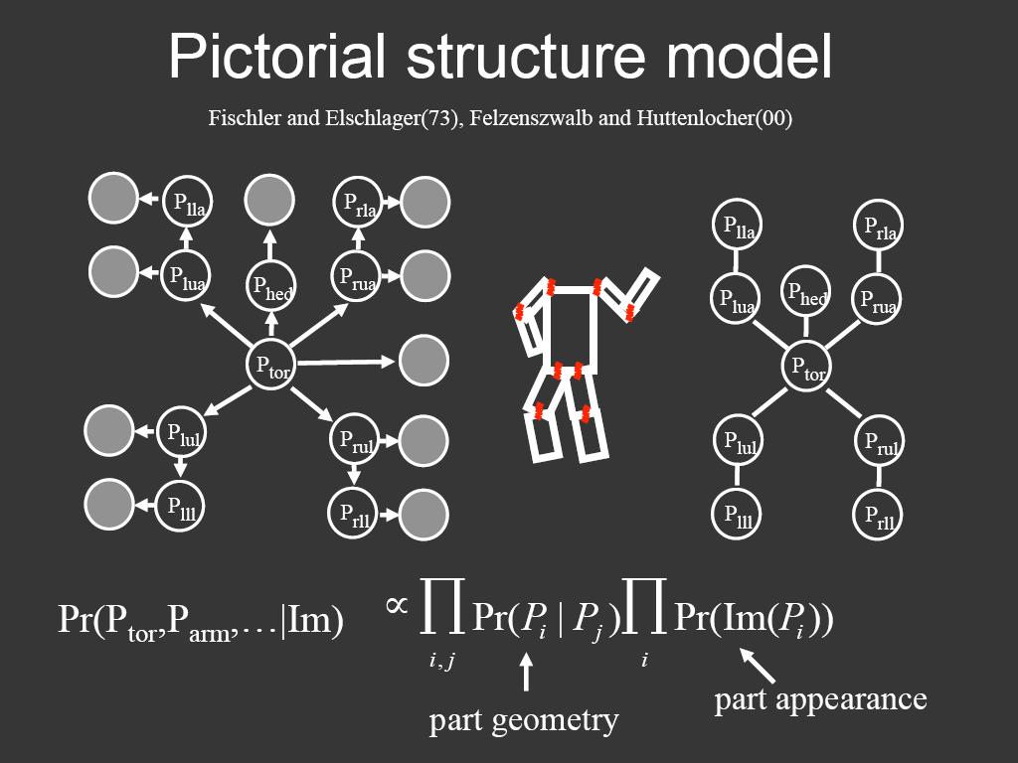
Representing people

Slide 51
Temporal model
Parts cannot move too far

Slide 52
Example results
http://www.ics.uci.edu/~dramanan/papers/pose/index.html

Slide 53
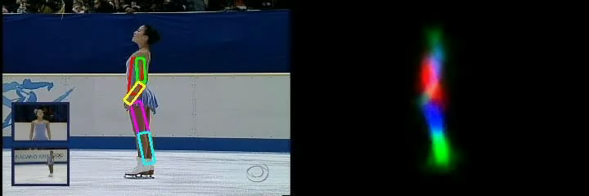
Video
http://www.ics.uci.edu/~dramanan/papers/pose/index.html

Slide 54
Things to remember
Tracking objects = detection + prediction
Probabilistic framework
Predict next state
Update current state based on observation
Two simple but effective methods
Kalman filters: Gaussian distribution
Particle filters: multimodal distribution

Slide 55
Next class: action recognition
Action recognition
What is an “action”?
How can we represent movement?
How do we incorporate motion, pose, and nearby objects?

